Slide 1

Auraria Library
Strategic Plan 2030
Laurel Schwaebe
Notes:
https://library.auraria.edu/about/strategic-plan

Slide 2

How to access:
Notes:
Fairly easy to find, but not accessible from the front page.

Slide 3
Phase I: Discover
Becoming an indispensable partner begins with discovery. This three-year period, from 2021-2023, motivated the Library’s employees and leadership to discover how best to position the Library’s strategic direction in alignment with the University of Colorado Denver, Metropolitan State University of Denver, and the Community College of Denver.
Notes:
This is a three-phase plan. Currently, we are on Phase: 1, which seems to be a brainstorming and research phase. What’s unique about this library is that it is connected to three individual institutions, which makes this phase extra important.
Unique student needs
Levels of control and funding
Fit on campus and in multi-institutional culture

Slide 4

Discover, Transform, Inspire
In 2020, the Auraria Library set out to discover new opportunities to support the diverse populations of the Auraria Campus, transform our services to better meet users wherever they are, and teach research skills to enable and inspire life-long learning.
Notes:
This seems fine as a fairly basic mission statement and introduction to the plan.

Slide 5
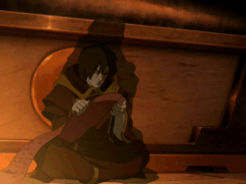
Strategic Goals
Support
EDI
Culture
Workforce
Communication
Stakeholders
Funding
Collaboration
1
2
Support the diverse populations of the Community College of Denver, Metropolitan State University of Denver, and University of Colorado, Denver in achieving academic success.
Integrate equity, diversity, and inclusion (EDI) practices and methodologies across all library operations, services, and collections.
3
4
Maximize scholarly and creative activities for all library employees and support a culture of research and engagement with the profession on a national scale while allocating resources for professional development and related activities.
Support, train, retain and recruit an engaged and diverse workforce, whose priorities and opportunities align with the library’s strategic directions and take into account all aspects of the employee engagement lifecycle.
5
6
Communicate internally, with the campus community, and the public at large to showcase the Library’s impact in supporting tri-institutional goals and priorities.
Communicate internally, with the campus community, and the public at large to showcase the Library’s impact in supporting tri-institutional goals and priorities.
7
8
Pursue diversified sources of funding to support strategic initiatives, collections, and core operations while strategically allocating existing resources to ensure responsible fiscal stewardship.
Establish a strategic collaboration framework that enables us to develop strong relationships and formalize partnerships at all levels.
Notes:
There are good overall goals. However, there are no links, no further information, nothing. This is the discovery phase, so one can’t expect concrete goals and numbers, but this is nonetheless lacking.

Slide 6

Accountability Tracker
 | Goal 1 | Goal 2 | Goal 3 | Goal 4 | Goal 5 | Goal 6 | Goal 7 | Goal 8
Planning
In Progress
Complete
Notes:
No idea what progress has actually been made, who is making progress, who is managing the plan, when they last updated, etc. Again, no links, no further information.

Slide 7
Future Phases
Phase II: Transformation
Phase III: Inspiration
Starting in 2024, the Library will take what we discovered during Phase I and use it to transform—reimagine our services programming, and resources in order to better meet the students, faculty, and staff of the Auraria Campus wherever they are along their educational journey.
Starting in 2027, the Library will look back on how we’ve discovered and transformed ourselves during Phase I and Phase 2. This process of reviewing how far we’ve come and how we might have inspired our users to become life-long learners will point us towards new opportunities.
Notes:
We can expect to see actual numbers in these phases, but for now, we will have to wait.

Slide 8


The Good, the Bad, & the Ugly
Good
Bad (& Ugly)
No tangible goals in this phase
The entirety of the strategic action plan is actually in Phase II
Limited information on goals, barebones in general
No information on goal tracking indicators
No indication who is responsible for the plan, who updated the plan, or when it was last updated
Easy to navigate and read
Accessible, screen-reader friendly
Provides a good sense of what the library stands for

Slide 9
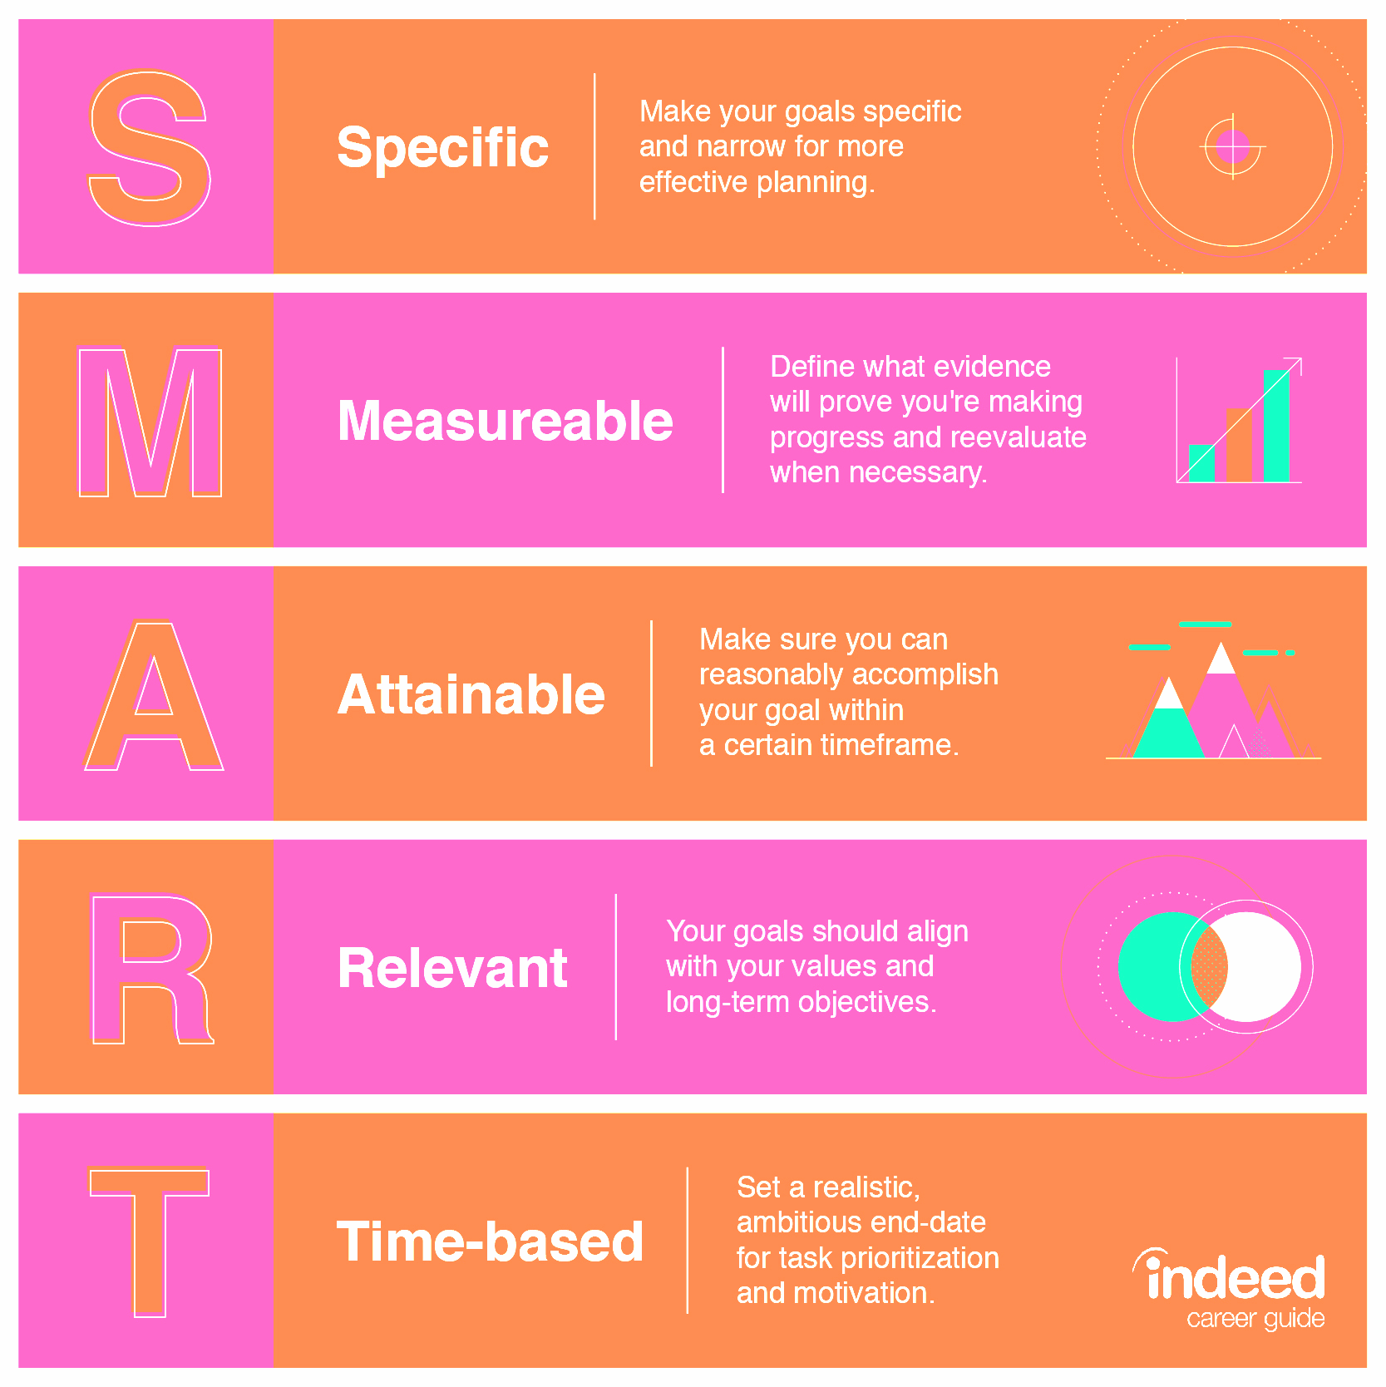
Sure.
(I guess)
X
In summary:
?
?
✓
✓
Notes:
Lackluster, nonspecific. No clear outcome goals,

